Slide 1
LINQ to Objects
Venkat Shiva Reddy
Technical Trainer
avvsreddy@gmail.com
Notes:
11

Slide 2
Topics
LinqBooks Running Example
Querying Collections
Using LINQ with ASP.NET
Using LINQ with WinForms
Major Standard Query Operators

Slide 3
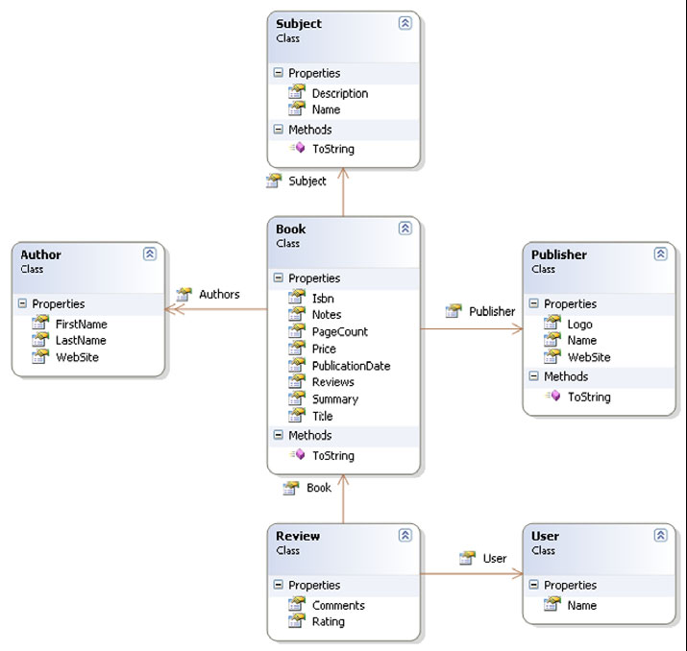
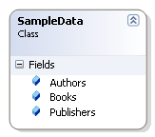
LinqBook Example
A personal Book-Cataloging system.
  Rich object model to use complete LINQ tool set.
Business Entity Classes:
Book
Author
Subject
Publisher
Review
User

Slide 4

What we can query?
Collections
  Must implements IEnumerable<T> interface
Arrays
Generic Lists
Generic Dictionaries
Strings
Non Generic Collections

Slide 5
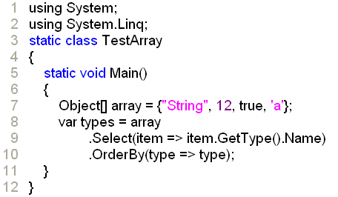
LINQ with Arrays
Any kind of Array is supported.
  It can be un-typed array of objects

Slide 6
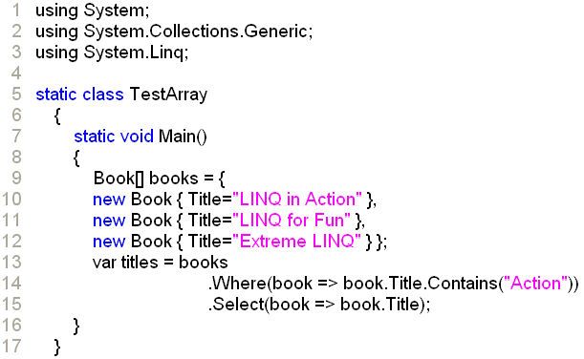
LINQ with Arrays
Querying a typed array with LINQ to Objects

Slide 7
LINQ with Generic List
LINQ to Objects can work with all Generic Lists
  System.Collections.Generic.List<T>
  System.Collections.Generic.LinkedList<T>
  System.Collections.Generic.Queue<T>
  System.Collections.Generic.Stack<T>
  System.Collections.Generic.HashSet<T>
  System.Collections.ObjectModel.Collection<T>
  System.ComponentModel.BindingList<T>

Slide 8
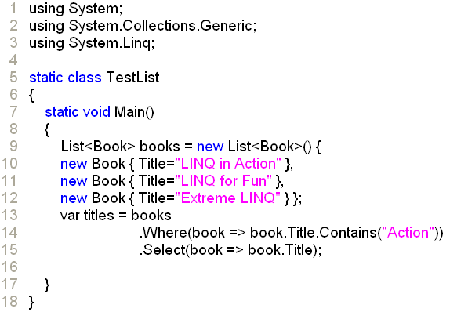
LINQ with Generic List
Querying a Generic List with LINQ to Objects

Slide 9
LINQ with Generic Dictionaries
All Generic Dictionaries can be queried using LINQ to Objects
  System.Collections.Generic.Dictionary<Tkey, Tvalue>
  System.Collections.Generic.SortedDictionary<Tkey, Tvalue>
  System.Collections.Generic.SortedList<Tkey, Tvalue>
Generic dictionaries implement IEnumerable<KeyValuePair<TKey, TValue>>.
The KeyValuePair structure holds the typed Key and Value properties.

Slide 10
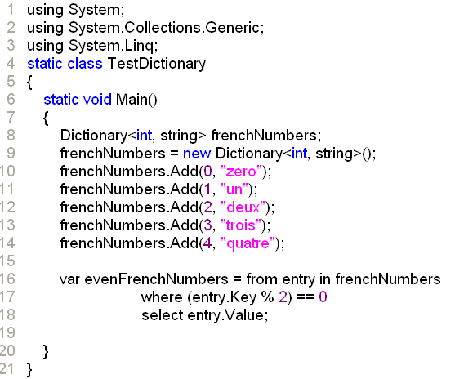
LINQ with Generic Dictionaries
Querying Generic Dictionary with LINQ to Objects

Slide 11
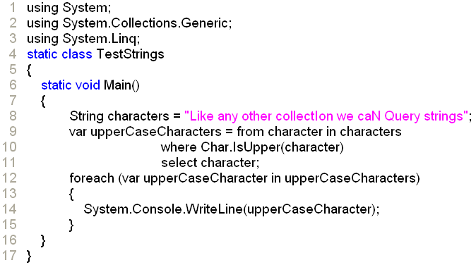
LINQ with Strings
String objects implements IEnumerable<Char>
String objects can be queried like any other collection

Slide 12
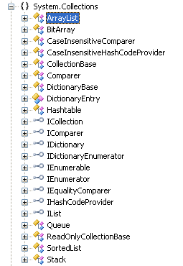
LINQ with Non-Generic Collections
Non-Generic Collections will implements IEnumerable interface.
But LINQ to Objects was designed to query generic collections that implements IEnumerable<T> interface
Convert Non-Generic Collections to Generic Collections Using
  Cast<T> or
  OfType<T> operators or
  Type declarations in query expressions

Slide 13
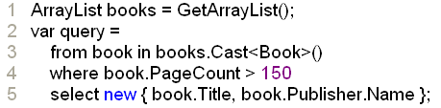
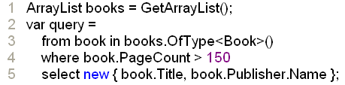

LINQ with Non-Generic Collections
Using Cast<T> Operator
Using OfType<T> Operator
Using type declaration in the query expression

Slide 14
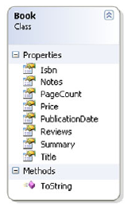
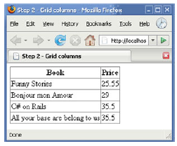

Using LINQ in ASP.NET

Slide 15
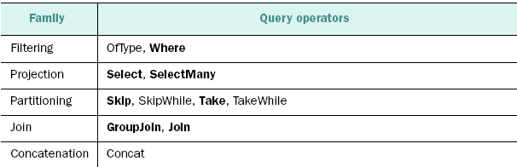
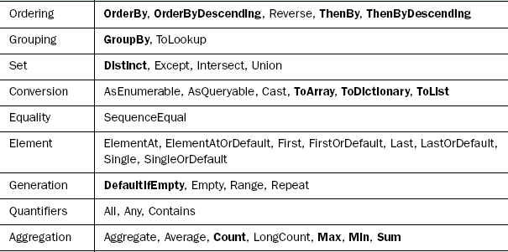
LINQ: Query Operators

Slide 16
Standard Query Operators
These work similarly to their SQL counterparts
  Select
  Where
  OrderBy/ThenBy
  OrderByDescending/ThenByDescending
  GroupBy
  Count
  Sum/Min/Max/Average

Slide 17
Positional Query Operators
First/FirstOrDefault
  Returns first element satisfying a predicate
ElementAt
  Returns element at a numeric position
Take/Skip
  Returns all elements before/after a numeric position
TakeWhile/SkipUntil
  Returns elements while predicate satisfied
Reverse
  Returns elements in reverse order
Range
  Returns subset of elements in a range

Slide 18
Set Based Query Operators
Combine two sets of elements
  Union
    Returns all distinct elements in both sets
  Intersection
    Returns only elements belonging to both sets
  Except
    Returns elements in Set A but not in Set B
  Repeat
    Returns duplicate copies of a set of elements
  Distinct
    Removes duplicate elements

Slide 19
Join Operators
To work with relations
Join operator ~ INNER join
GroupJoin ~ LEFT OUTER join

Slide 20
Ordering Operators
OrderBy
  Order First element in ascending order
OrderByDescending
  Order First element in descending order
ThenBy
    Order Next elements in ascending order
ThenByDescending
    Order Next elements in descending order

Slide 21
Conversion Operators
AsEnumerable()
  Returns IEnumerable<T> wrapper for collections that don’t implement IEnumerable (eg. DataTable)
  To cast when types implement IEnumerable and IQueryable
ToArray()
  Usefull for legacy integration
ToList()

Slide 22


DEMO – Projection Operators
Select
  Used to perform a projection over a sequence, based on the arguments passed to the operator.
  Select operator allocates and yields an enumeration.
Declaration
Example

Slide 23

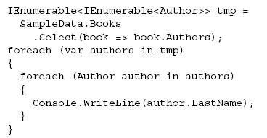
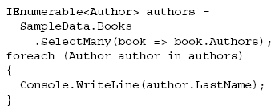
DEMO – Projection Operators
SelectMany
  It is similar to Select operator except that its selector returns a sequence.

Slide 24


Where, the restriction operator
The Where operator filters a sequence of values based on some criteria.
Where enumerates a source sequence yielding only those values that match the predicate you provide.
Declaration:
Example:

Slide 25
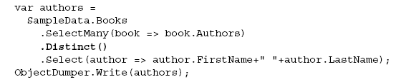
Using Distinct
Distinct eliminates duplicate elements from a sequence
In order to compare the elements, the Distinct operator uses the elements’ implementation of the IEquatable<T>.Equals() method if the elements implement the IEquatable<T> interface.
It uses their implementation of the Object.Equals() method otherwise.

Slide 26



Using Conversion Operators
ToArray()
  Converts a sequence to a typed Array
ToList()
  Converts a sequence to a typed List
ToDictionary()
  Converts a sequence to a typed Dictionary.
Used for Immediate execution of a query or cache the result of a query.
By default, queries return sequences, collections implementing IEnumerable<T>:
Convert the sequence to:

Slide 27
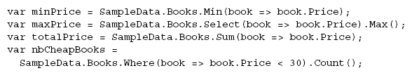
Using Aggregate Operators
Count
  Which counts the number of elements in a sequence
Sum
  Which computes the sum of sequence of numeric values
Min and Max
  Which find the Minimum and Maximum of a sequence of numeric values respectively.
Examples:

Slide 28
Using OrderBy Operator for Sorting
Use OrderBy Operator or orderby clause to sort the collection
The orderby keyword used to specify several orderings.
  By default is ascending order.
  Use descending keyword for descending order.
The OrderBy operator along with ThenBy, OrderByDescending and ThenByDescending used to specify several orderings.

Slide 29



LINQ: Sorting
Using orderby clause:
Using OrderBy Operator:
A query expression’s orderby clause translates to a composition of calls to the OrderBy, ThenBy, OrderByDescending, and ThenByDescending operators.

Slide 30
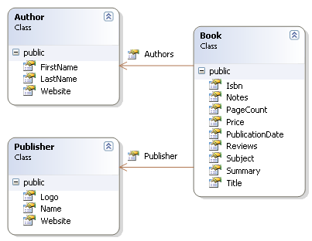
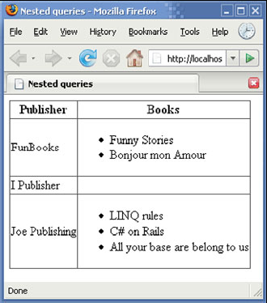
LINQ: Nested Queries
Used to Join more than one collection

Slide 31
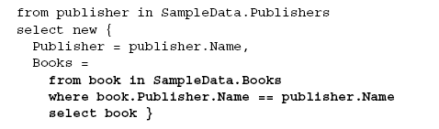
LINQ: Nested Queries
Code Sample:

Slide 32

LINQ: Grouping
GroupBy Operator
  Just like the GROUP BY clause of SQL, the GroupBy operator groups elements of a sequence based on a given selector function.
  Each GroupBy operator returns an
  IEnumerable<IGrouping<K,E>>.
Example:

Slide 33

LINQ: Joins
Join operators allow us to perform the same kind of operations as projections, nested queries, or grouping do, but their advantage is that they follow a syntax close to what SQL offers.

Slide 34

Question Time
Please try to limit the questions to the topics discussed during the session.
Participants can clarify other doubts during the breaks.
Thank you.

